Slide 1
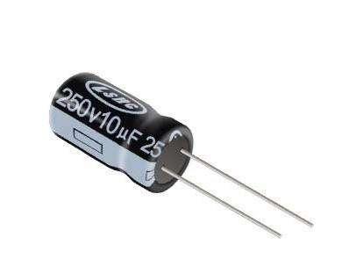
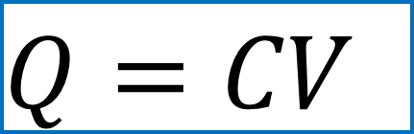
Capacitors
$$Q=CV$$
capacitance

Slide 2




For parallel-plates,
without dielectrics,
The equivalent capacitance of serial capacitors
The equivalent capacitance of parallel capacitors
Total energy stored in a capacitor:

Slide 3



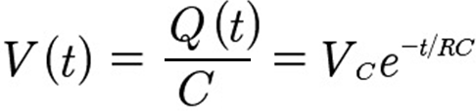

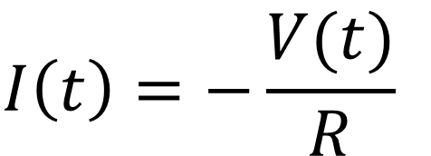

Time constant of RC circuit
$$τ=RC$$
Charging a capacitor:
increasing
decreasing
Discharging
a capacitor
$$I\left(t\right)=−\frac{V(t)}{R}$$
All decreasing

Slide 4
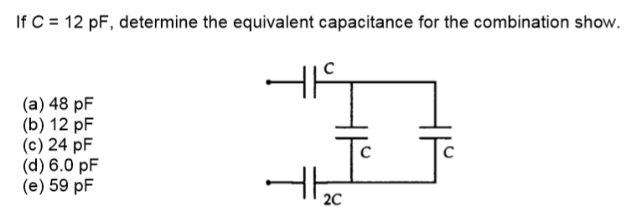
d
2C
C

Slide 5
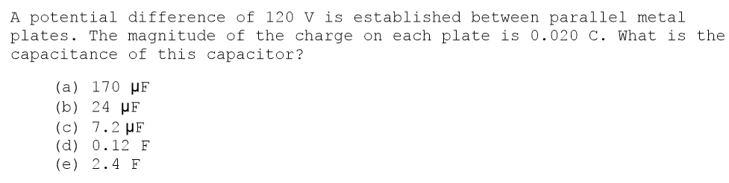
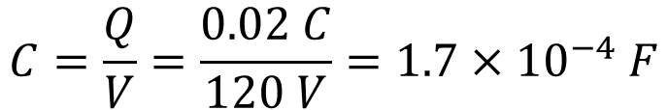
A
$$C=\frac{Q}{V}=\frac{0.02 C}{120 V}=1.7×{10}^{−4} F$$

Slide 6
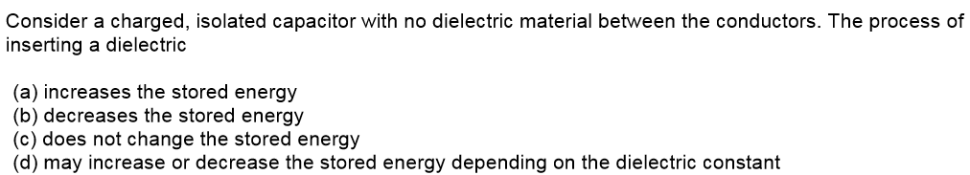
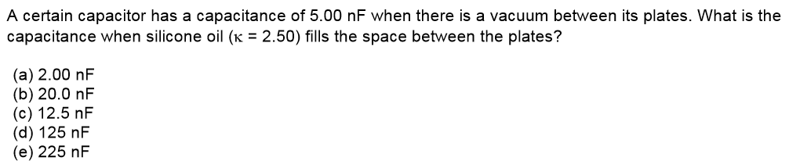




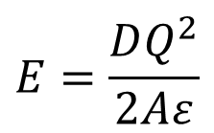
B
$$E=\frac{DQ^{2}}{2Aε}$$
$ε↑ ⇒ E↓$
$$C∝ε$$
C

Slide 7
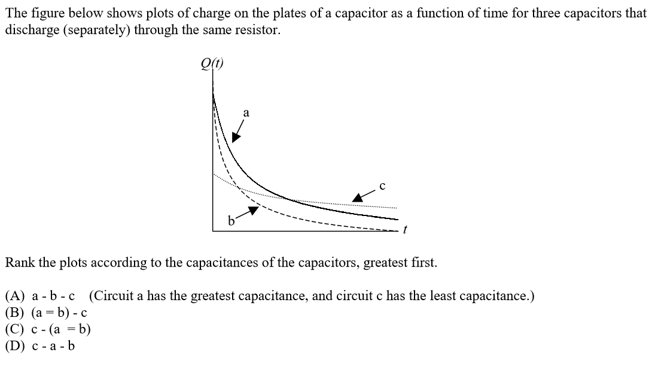

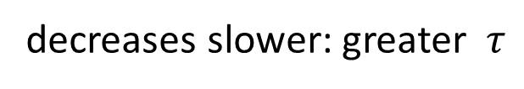
$$τ=RC$$
decreases slower: greater $τ$
greater C
D

Slide 8
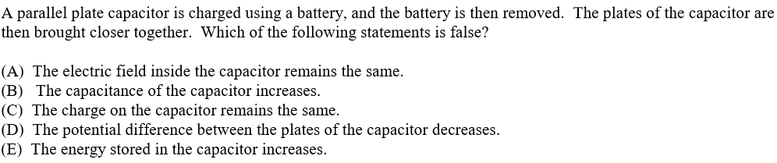

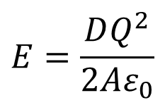

E
constant Q !
$$Q=CV$$
$$E=\frac{DQ^{2}}{2Aε_{0}}$$
constant charge density
constant electric field
$$D↓ ⟹C↑ ⟹V↓ ⟹E↓$$

Slide 9
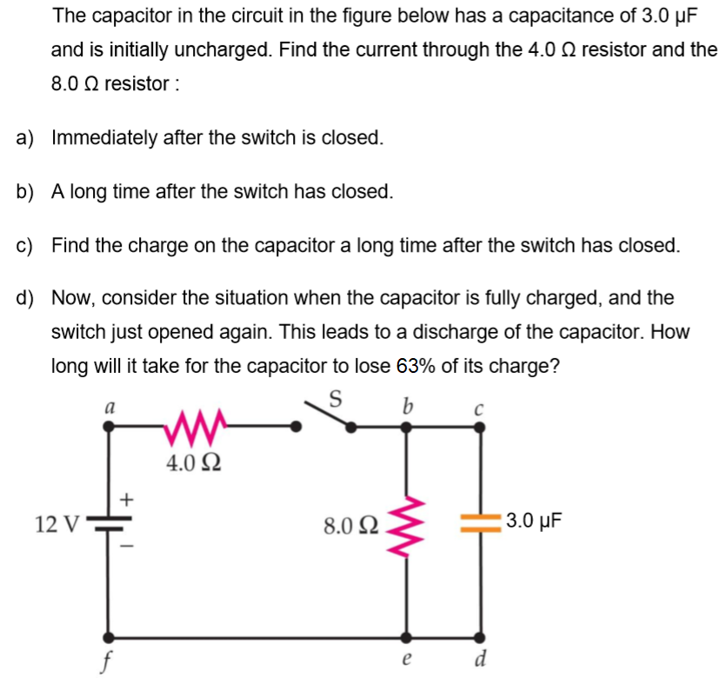

$$4Ω: 3 A 8Ω: 0 A$$
12 V
0 V
12 V
Q = 0
0 V
V = 0
0 V
0 V

Slide 10






$$4Ω: 3 A 8Ω: 0 A$$
$$4Ω:1 A 8Ω:1 A$$
$$24 μC$$
$$τ=24 μs$$
$$e^{−\frac{t}{τ}}$$
$$t=τ=RC$$
V = 8 V
Q = CV

Slide 11
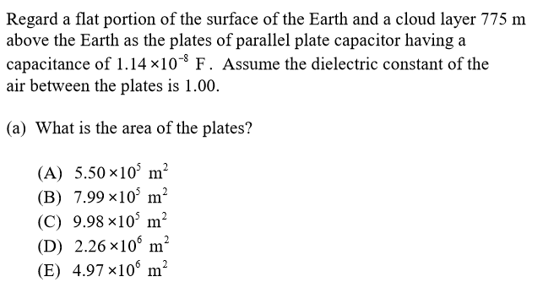
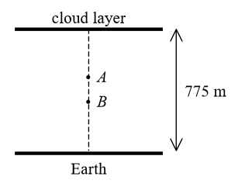

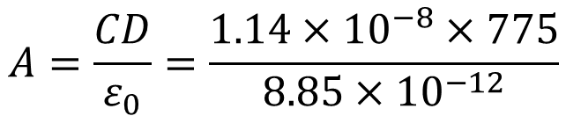
C
$$A=\frac{CD}{ε_{0}}=\frac{1.14×{10}^{−8}×775}{8.85×{10}^{−12}}$$
$$=9.98×{10}^{5} m^{2}$$

Slide 12
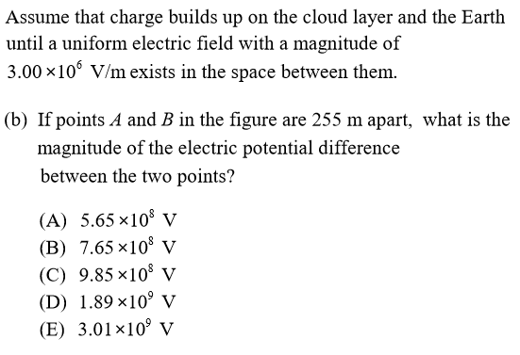
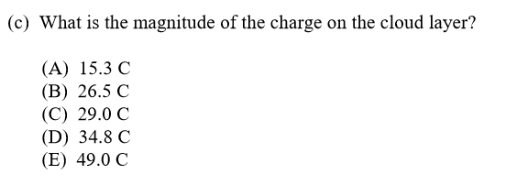



B
$$V=E×d=7.65×{10}^{8} V$$
B
$$Q=CV=C∙E∙D$$
$$=1.14×{10}^{−8}×3×{10}^{6}×775$$
$$=26.5 C$$

Slide 13
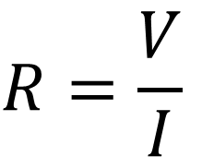
An infinite resistance grid: all resistors are identical. Each has the resistance R. What is the equivalent resistance between the two adjacent junction?
I
V
$$R=\frac{V}{I}$$

Slide 14
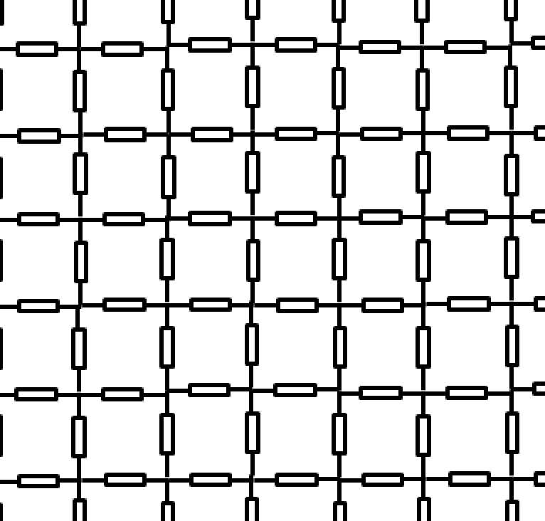
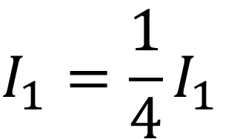
Situation 1
$$I_{1}=\frac{1}{4}I_{1}$$
I₁
I₁
I₁
I₀
I₁

Slide 15
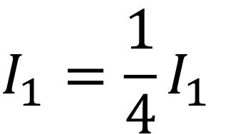
Situation 2
I₁
I₁
$$I_{1}=\frac{1}{4}I_{1}$$
I₁
I₀
I₁

Slide 16


Situation 1+2 = Situation 3
I₁
½ I₀
I₁
I₀
I₀
$$∆V=IR=\frac{I_{0}R}{2}$$
$$R_{eq}=\frac{∆V}{I_{0}}=\frac{R}{2}$$

Slide 17
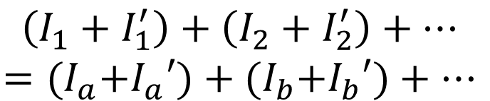
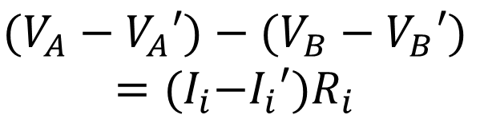



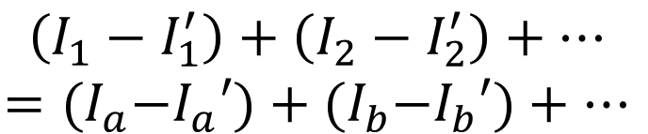
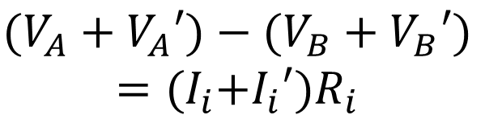
Junction
(conservation of charge)
Potential difference between two points A & B
1
$$I_{1}+I_{2}+…=I_{a}+I_{b}+…$$
$$V_{A}−V_{B}=I_{i}R_{i}$$
2
$$I_{1}′+I_{2}′+…=I_{a}′+I_{b}′+…$$
$$V_{A}′−V_{B}′=I_{i}′R_{i}$$
$$\left(I_{1}+I_{1}^{′}\right)+\left(I_{2}+I_{2}^{′}\right)+…$$
$$={{(I}_{a}+I}_{a}′)+{{(I}_{b}+I}_{b}′)+…$$
√
√
1+2
$${(V_{A}+V}_{A}′)−(V_{B}+V_{B}′)$$
$$={{(I}_{i}+I}_{i}′)R_{i}$$
√
√
1-2
$$\left(I_{1}−I_{1}^{′}\right)+\left(I_{2}−I_{2}^{′}\right)+…$$
$$={{(I}_{a}−I}_{a}′)+{{(I}_{b}−I}_{b}′)+…$$
$${(V_{A}−V}_{A}′)−(V_{B}−V_{B}′)$$
$$={{(I}_{i}−I}_{i}′)R_{i}$$

